Slide 1

SMART AGRICULTURE MONITORING SYSTEM
BACHELOR of TECHNOLOGY
IN
ELECTRONICS & COMMUNICATION ENGINEERING
Batch Number:08
Department of Electronics and Communication Engineering
VIGNAN’S INSTITUTE OF INFORMATION TECHNOLOGY (A)
(Affiliated to JNTU-GV, Approved by AICTE & Accredited by NBA , NAAC with ‘A’ Grade)
(2022-2023)
Project Guide:
Dr. A. V. Bharadwaja
Associate Professor
By
P.NANDINI (21L31A04C8)
K.SAHITHI (21L31A04F0)
P.GAYATHRI SHREYA (21L31A04D0)
P.NITHIN SAI (21L31A04E6)
V.ADITHYA KIRAN (21L31A04H8)

Slide 2
CONTENTS
Abstract of present work
Introduction
Components
Block diagram
Methodology of work
Applications
Prototype Model
References

Slide 3
.
ABSTRACT
In this project, an internet of things based smart agriculture monitoring system has been developed to reduce manual labor and water wastage.
In this proposed system, a Node Microcontroller Unit integrates all of the sensors and sends the sensors data to an internet of things-based.
It sends the data about temperature, humidity and moisture of the soil.
It will save the man power and time efficient.
This project aims to improve agricultural productivity and reduce water wastage.

Slide 4
INTRODUCTION
Smart agriculture monitoring systems use technology to help farmers improve their farming practices and make better decisions.
These systems use special sensors to collect important information about the soil, weather, and crops.
The sensors send this information to a central platform or dashboard, where it can be easily accessed and analyzed.

Slide 5
.
COMPONENTS
Nodemcu ESP8266
Soil Moisture Sensor
PIR Motion Sensor
DHT11 Sensor
Relay Module
Breadboard
Jumper Wires
18650 Battery
Push Button
Water Pump

Slide 6
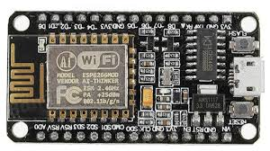
Nodemcu ESP8266
NodeMCU ESP8266 is an open-source development board based on the ESP8266 Wi-Fi chip.
It combines the microcontroller unit
and Wi-Fi module in a single chip,
making it ideal for IoT projects.
NodeMCU ESP8266 boards are commonly used in home automation, robotics, sensor monitoring, and other IoT applications.

Slide 7
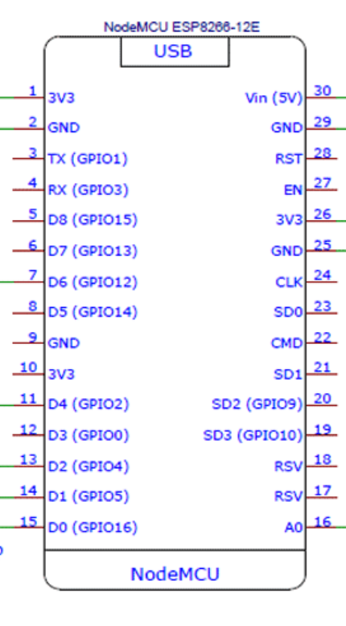
PIN DIAGRAM FOR NODEMCU ESP8266

Slide 8
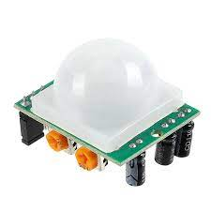
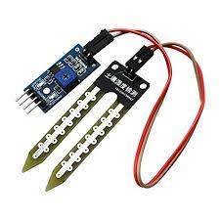
PIR Motion Sensor
Passive Infrared motion sensors are electronic devices that detect changes in infrared radiation emitted by objects in their field of view to detect motion.
(a)PIR Motion Sensor (b)Soil Moisture Sensor
Soil Moisture Sensor
Soil moisture sensors are electronic devices used to measure the moisture content in the soil.

Slide 9
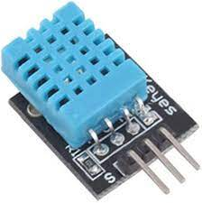
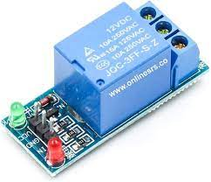
.
DHT11 Sensor
The DHT11 sensor is a digital temperature and humidity sensor commonly used in projects and applications that require monitoring of environmental conditions.
Relay Module
A relay module is an electrical switch that is operated by an electromagnet.

Slide 10
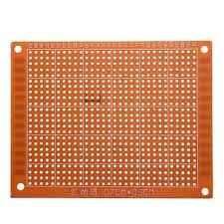
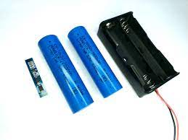
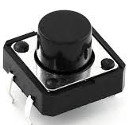
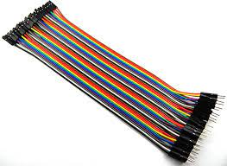
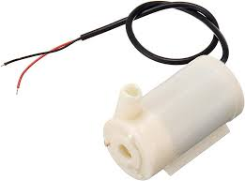
.
Bread Board
Batteries
Push Button
Jumper Wires
Water Pump

Slide 11
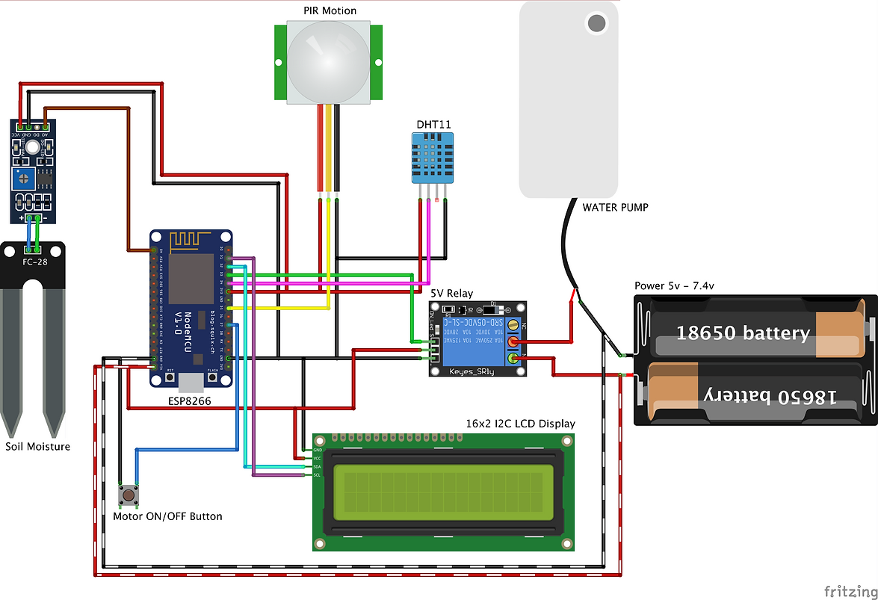
.
BLOCK DIAGRAM
PIR MOTION SENSOR

Slide 12
.
Methodology of work
Smart agriculture using IOT can be basically termed as a building wireless system for automating the irrigation process and monitoring the crop field
This can be done with the help of various sensors like humidity, temperature and soil moisture sensors.
The system response appropriately by watering the soil with the exact amount of water required and then shuts down the water supply when the required amount of soil moisture is achieved

Slide 13
APPLICATIONS
Monitoring of Soil Moisture and Water Levels
System of Irrigation Monitoring
Yield Monitoring, Forecasting and Harvesting
Climate Conditions Monitoring

Slide 14
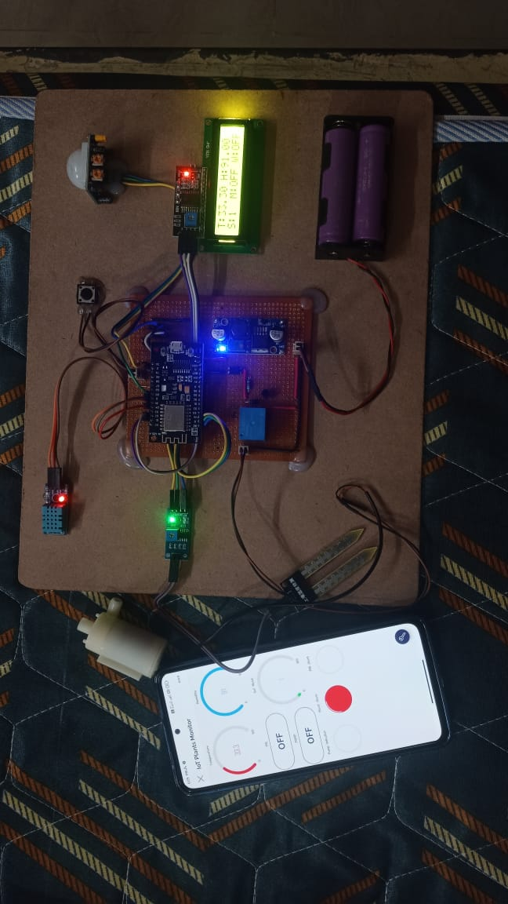
.
PROTOTYPE MODEL

Slide 15
REFERENCES
[1] Sathyam Bonala and Keerti Kumar, “IOT Based Smart Agriculture Monitoring System”, International Journal of Scientific Engineering and Research (IJSER), pp. 31-34, 2021.
[2] D.Betteena Sheryl Fernando, “Smart Agriculture Monitoring System Using IoT”, International Journal of Scientific Research and Engineering Trends, Volume 6, Issue 4, July-Aug-2020.
[3] Joaquin Gutierrez, Juan Francisco Villa-Medina et.al, “Automated Irrigation System Using a Wireless Sensor Network and GPRS Module”, IEEE Transactions on Instrumentation and Measurement, 2013.
[4] https://en.Wikipedia.org.
[5]https://www.viralsciencecreativity.com/post/blynk-iot-smart-plant monitoring-system

Slide 16
THANK YOU

